Slide 1
A Material Classification Protocol for a Mechatronic Platform
Giovanni Luca Biundo
Ivan Brillo
A.Y 2024/2025
Data Mining and Machine Learning Project

Slide 2
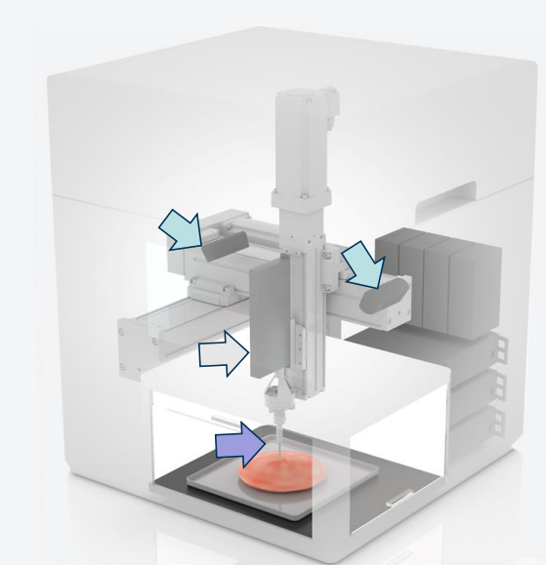


INTRODUCTION TO THE PROBLEM
Accurate material classification is critical in engineering and biomedical fields.
Challenges:
MACHINE USED
Extracting relevant features from heterogeneous sensor data
Custom mechatronic platform developed for precise material testing.
Tri-axial motorized stage.
Linear actuator for controlled interaction
High-precision load cell for sensitive force measurement
Traditional methods (e.g., visual inspection, destructive testing) are often impractical.
Handling boundary effects and experimental variability
GOAL: Develop a non-destructive, automated classification method using machine learning.

Slide 3
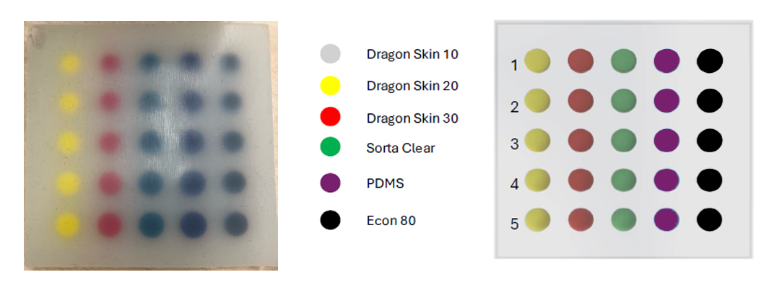
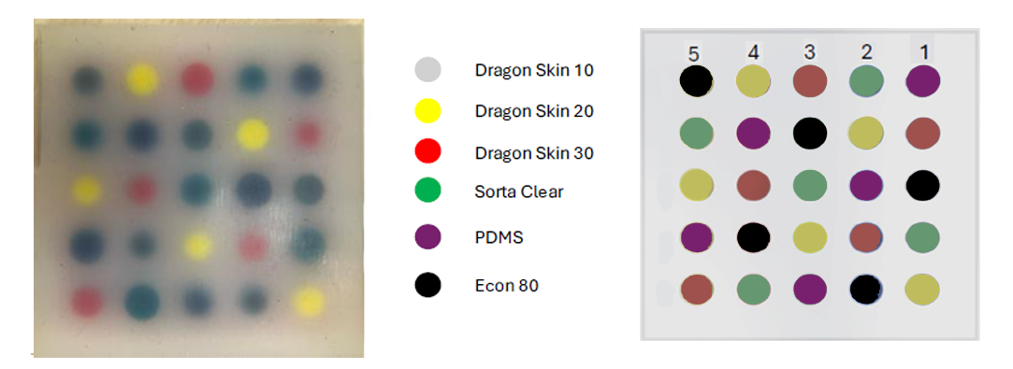
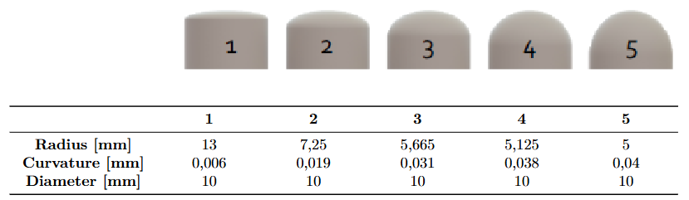
Accurate material classification is critical in engineering and biomedical fields.
Challenges:
DamasconeA :
2 measurments
MACHINE USED
Extracting relevant features from heterogeneous sensor data
Custom mechatronic platform developed for precise material testing.
Tri-axial motorized stage.
Linear actuator for controlled interaction
High-precision load cell for sensitive force measurement
TRAIN-SET
Traditional methods (e.g., visual inspection, destructive testing) are often impractical.
Handling boundary effects and experimental variability
DamasconeB :
1 measurment
TEST-SET
GOAL: Develop a non-destructive, automated classification method using machine learning.

Slide 4
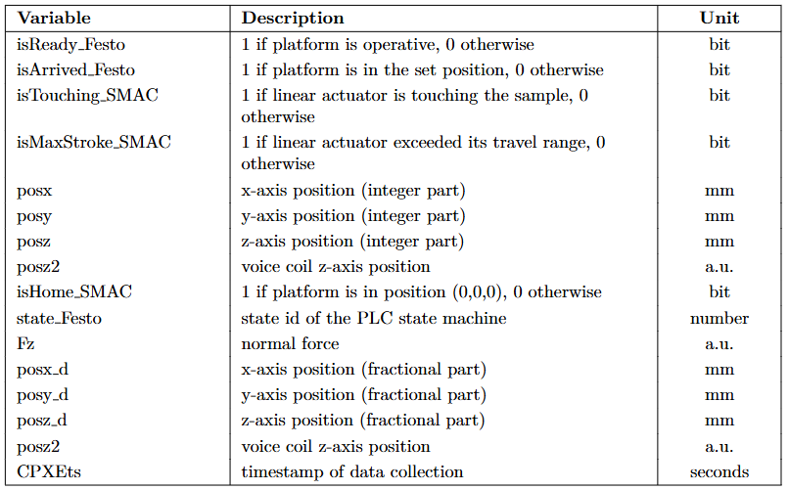
DATASET : TABLES
81 x 81 grid of points
DATASET : SAMPLES
DamasconeA :
2 measurments
TRAIN-SET
DamasconeB :
1 measurment
TEST-SET
MACHINE USED
Custom mechatronic platform developed for precise material testing.
Tri-axial motorized stage.
Linear actuator for controlled interaction
High-precision load cell for sensitive force measurement

Slide 5
DATASET : SAMPLES
DATASET : TABLES
81 x 81 grid of points
DamasconeA :
2 measurments
TRAIN-SET
DamasconeB :
1 measurment
TEST-SET

Slide 6

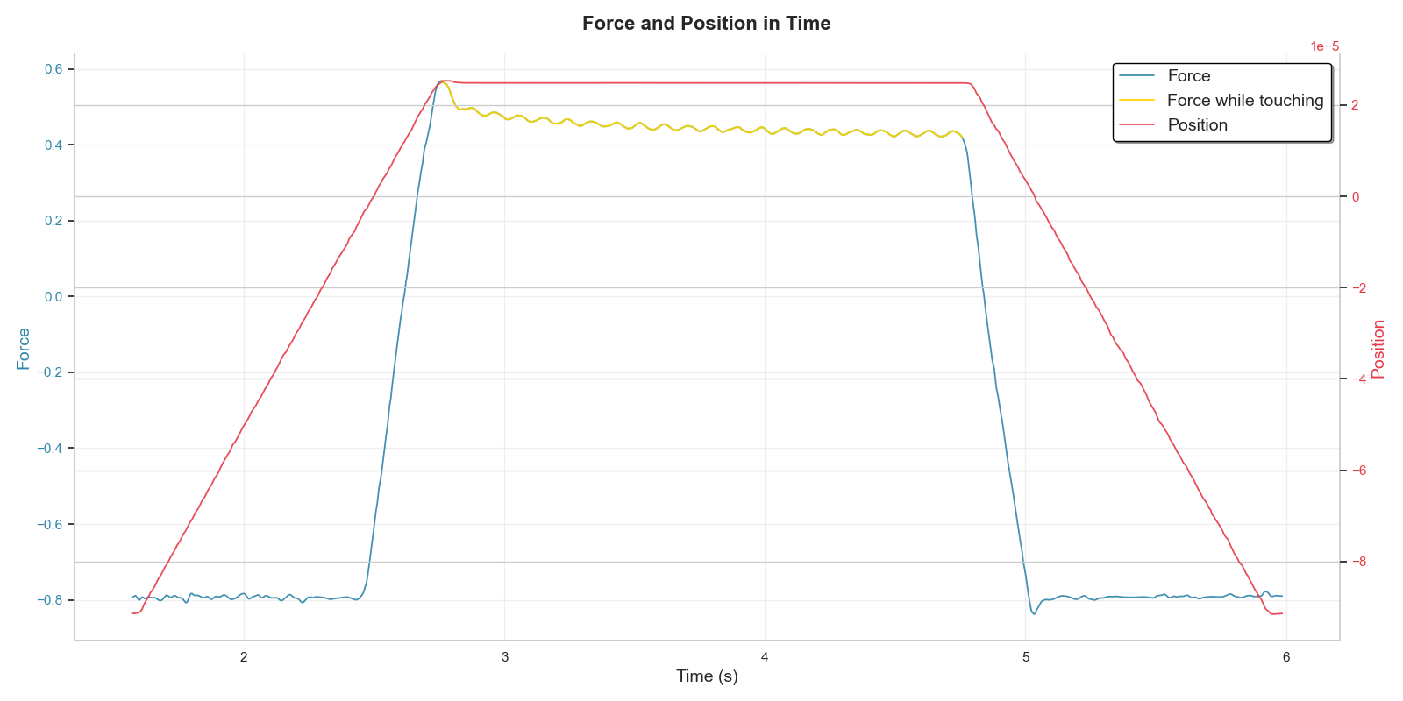








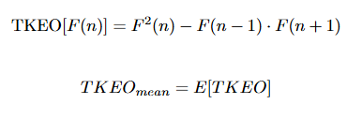









FEATURE EXTRACTION:
Feature Computation
81 x 81 grid of points
DATASET : TABLES
FEATURE EXTRACTION:
Signals Pre-processing
RAW SIGNAL
GAUSSIAN SMOOTHING
$$σ=2$$
NORMALIZATION
INTERPOLATION (1kHz)
CUBIC SPLINE
Extracted features: Stiffness, Tau, Entropy, Upstroke, Downstroke, Psteadystate, ForceOvershoot, ForceRelaxation, ForceRMS, DampingCoefficient, ContactArea, ForcePeakToPeak, Activity, Mobility, TkeoMean, CorrelationForcePosition, PeakRatio, SampleEntropy, LoadingSkewness, LoadingKurtosis, QuarticCoefficient.
STIFFNESS
DAMPING COEFFICIENT
UPSTROKE
TKEO-MEAN
DOWNSTROKE
MOBILITY

Slide 7
FEATURE EXTRACTION:
Signals Pre-processing
FEATURE EXTRACTION:
Feature Computation
STIFFNESS
DAMPING COEFFICIENT
UPSTROKE
TKEO-MEAN
DOWNSTROKE
MOBILITY

Slide 8
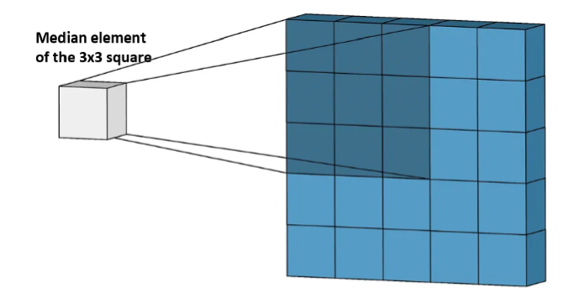
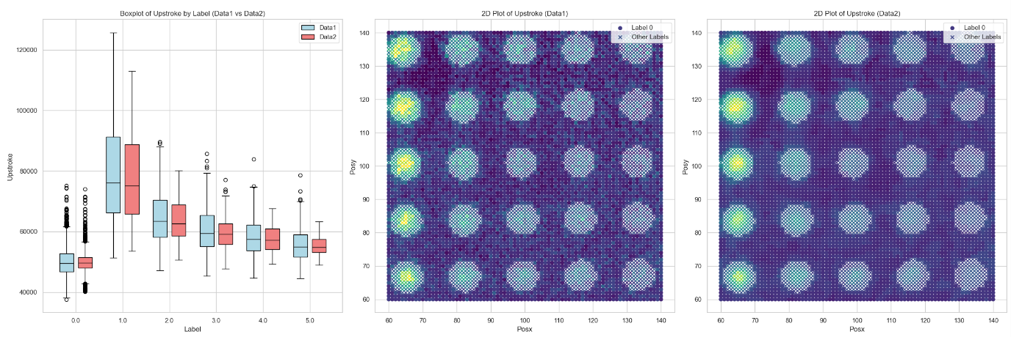
DATASET PREPROCESSING
NaN HANDLING
We used NearestNDInterpolator to fill feature points gaps in our 2D grid
SPATIAL SMOOTHING - MEDIAN
Perform a 3x3 spatial filtering using the median operation
Remove measurements noise and make the spatial data more homogenous

Slide 9
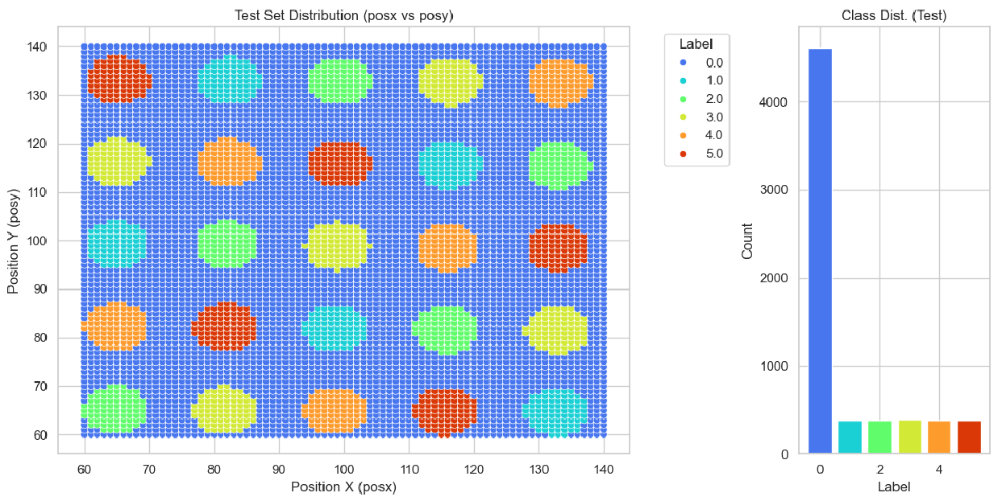
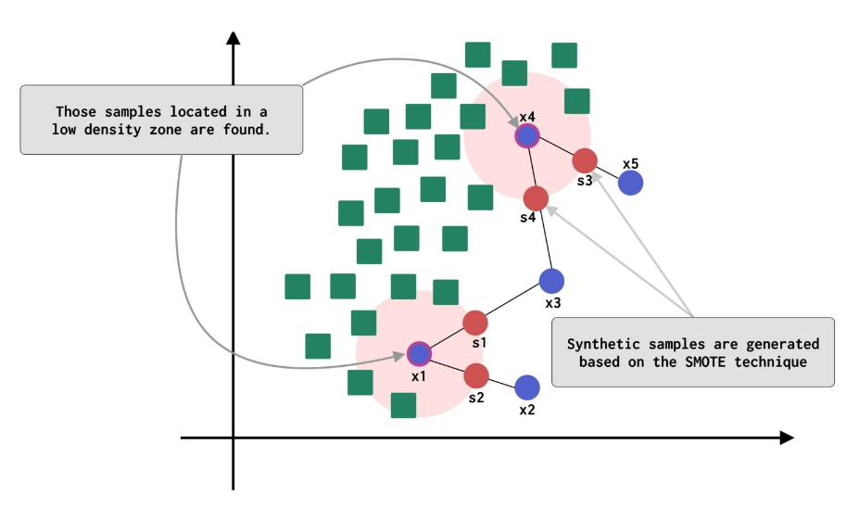
DATASET PREPROCESSING
DB SPLITTING
We divided the three objects in train, validation and test datasets
DATASET IMBALANCE - ADASYN
Works similar to SMOTE to perform minority classes oversample
But it favors points in low class density regions to start the oversampling and to generate points that are near the class decision boundaries

Slide 10
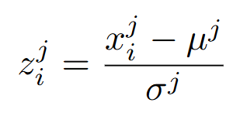
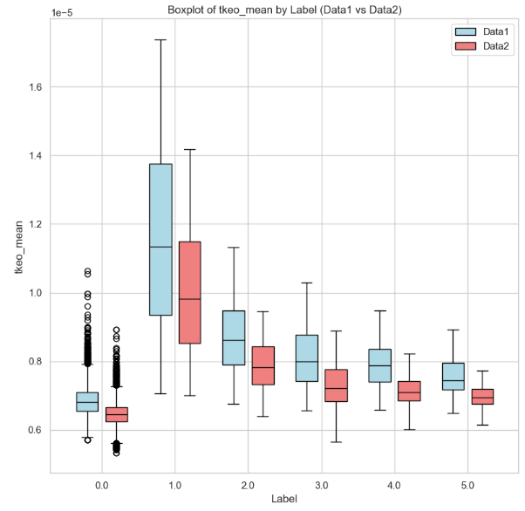
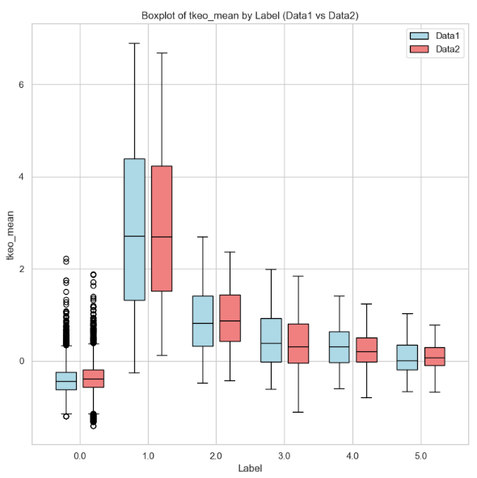
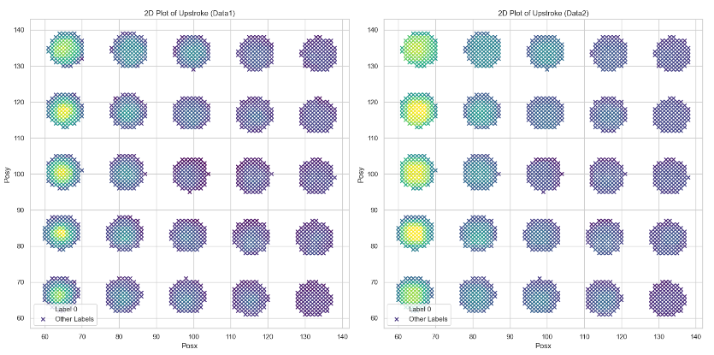
DATASET PREPROCESSING
SCALING
Avoid biases, improve Gradient Descent and regularization
Flatten features drift that arise from different experiment conditions
SPATIAL SMOOTHING - MAXIMUM
After detecting hard-spots points, we performed a 3x3 max filtering
Final FOV of our approach: 5x5

Slide 11
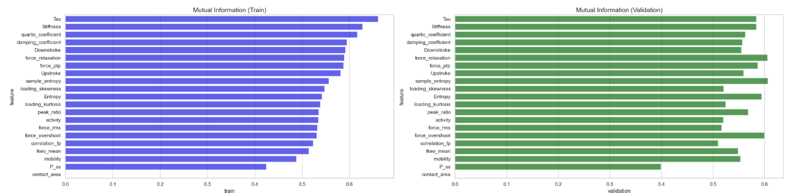
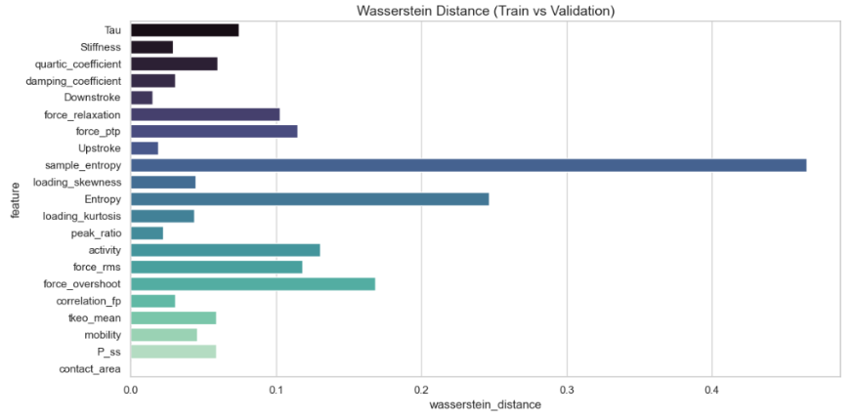
FEATURE SELECTION
MUTUAL INFORMATION
GLOBAL WASSERSTEIN DISTANCE
We want to find invariant features among experiments
Given two PDFs, one for training points and the other for validation points projected onto a single feature, their distance is defined as the minimum cost to transform one into the other

Slide 12
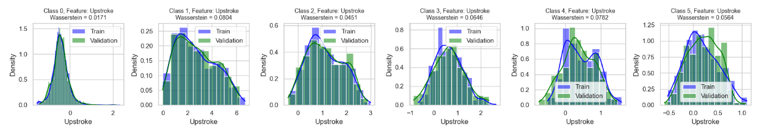
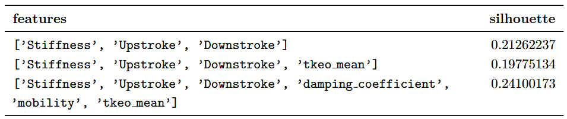

FEATURE SELECTION
PER-CLASS WASSERSTEIN DISTANCE
FEATURE SELECTION PIPELINE
th1 ∈ [0.025, 0.15], th2 ∈ [0.025, 0.2] for the two distances (MI not considered)
For all the pairs of (th1, th2) find all the features sets with lower distances
For each feature set with same number of features, calculate the silhouette score and keep only the higher one (since features clusters are approximately convex)

Slide 13
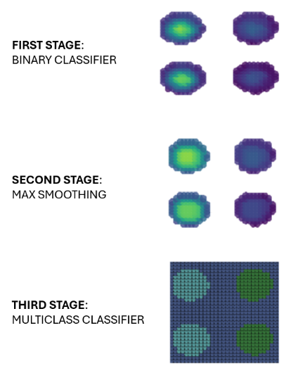
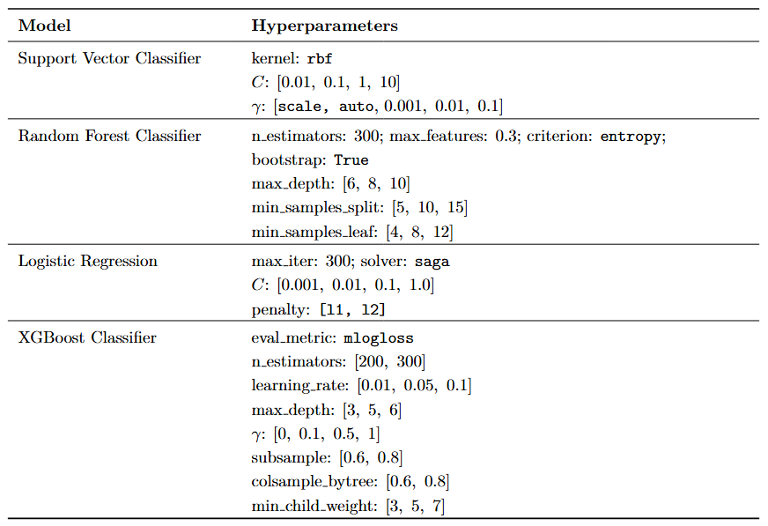
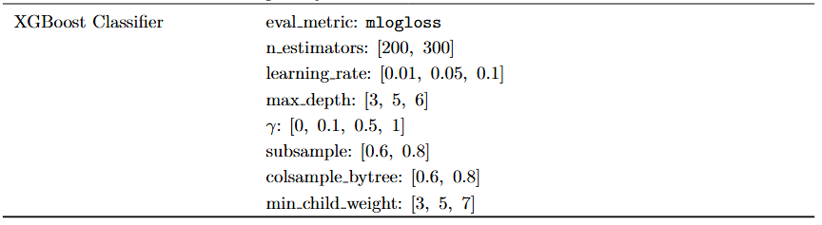
MODEL SELECTION AND HYPER-PARAMETERS TUNING
ENSEMBLE MODEL AND CROSS VALIDATION
We defined a custom ensemble model with binary and multiclass classifiers
We perform a 2-fold cross validation, training before on train dataset and evaluating on validation and vice-versa
RandomizedSearchCV
We define a randomized search over the features sets, the binary and multiclass models, and their hyperparameters
The best parameters set is chosen by f1-score macro

Slide 14
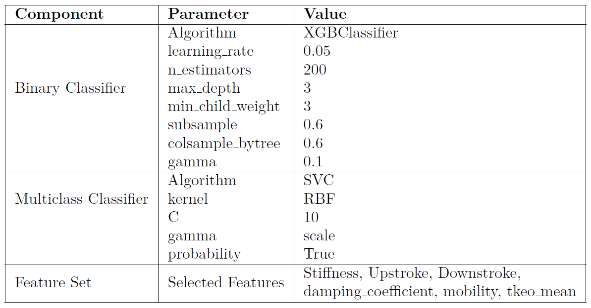
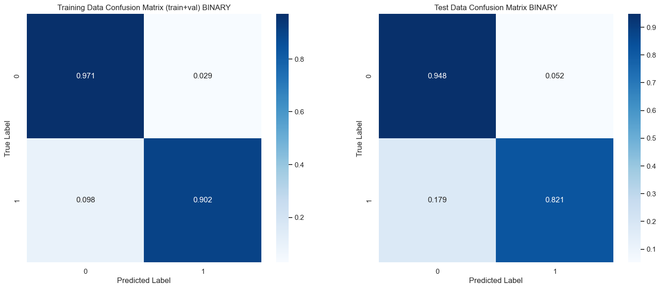
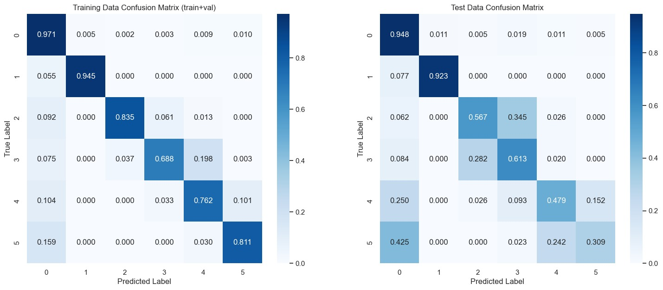
Considering the Binary Case (1)
RESULTS
BEST COMBINATIONS :
Best achieved f1-macro score during RandomSearchCV : 0.787

Slide 15
Considering the Binary Case (1)

Slide 16
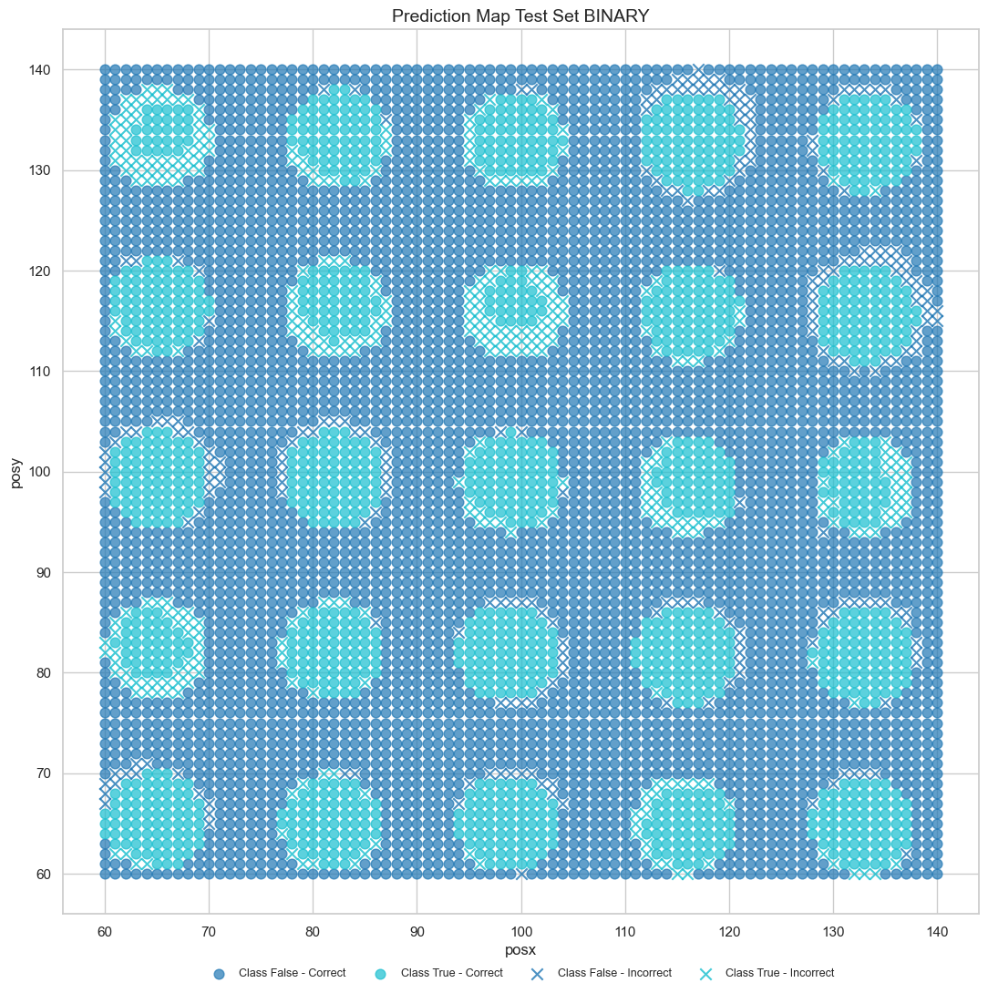

Considering the Binary Case (2)
CONFUSION MATRICES :

Slide 17
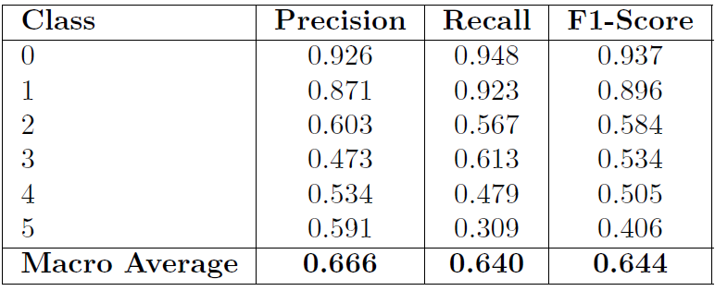
RESULTS
CONFUSION MATRICES :
SINGLE-VALUE METRICS :
Test set: DamasconeB
Overall accuracy: 0.8383
Macro F1-score: 0.6438

Slide 18
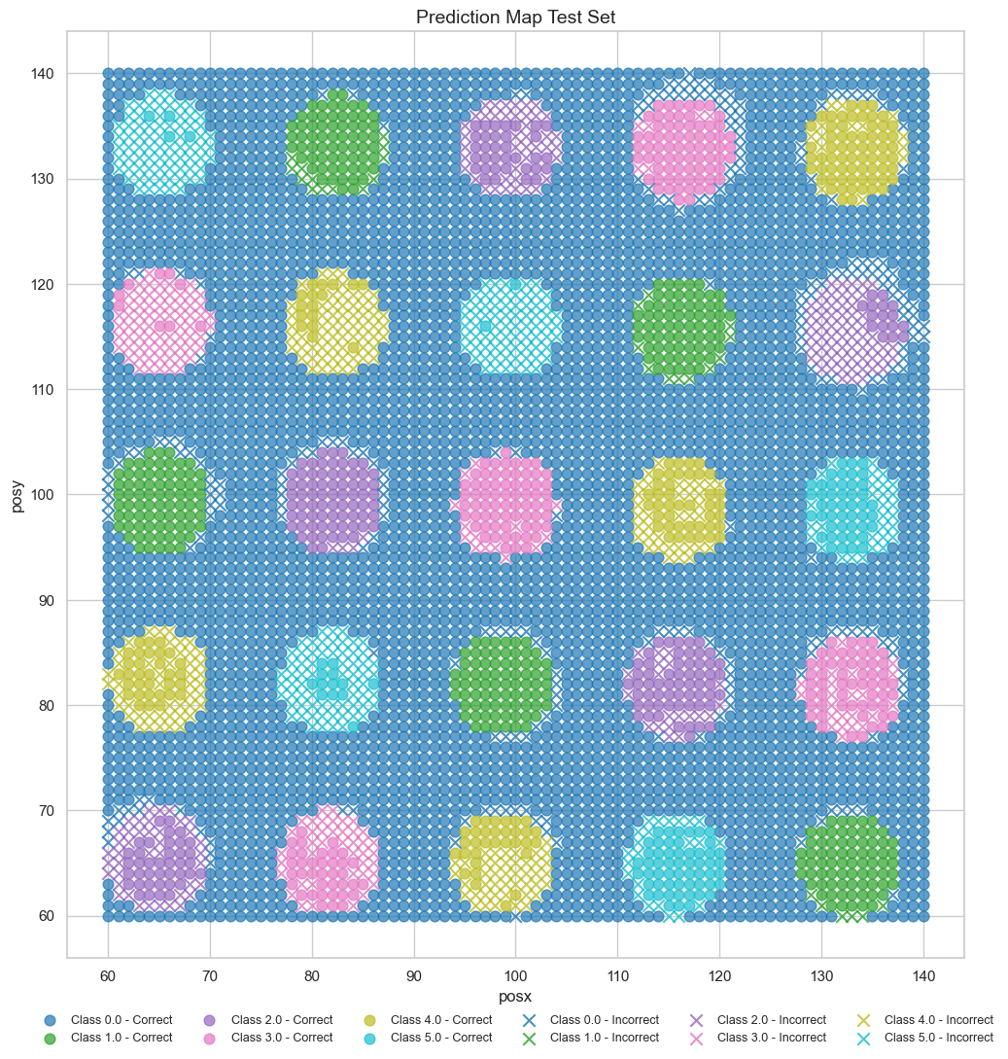
RESULTS
CONFUSION MATRICES :
SINGLE-VALUE METRICS :
PREDICTION MAP :

Slide 19
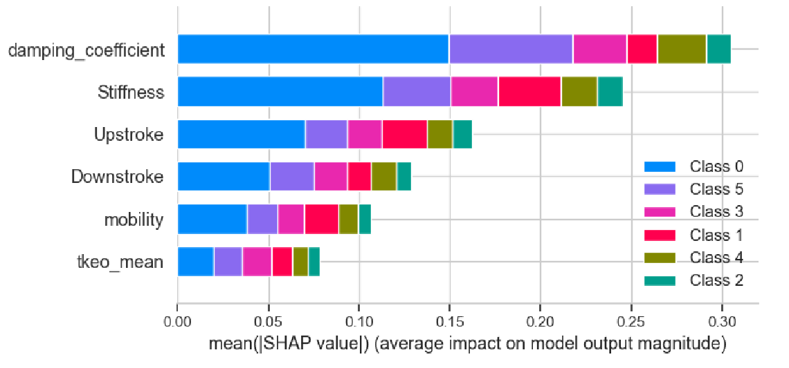

The classifier is still able to predict the right class for hard areas !
SINGLE-VALUE METRICS :
VALUABLE
FROM AN APPLICATION STANDPOINT
PREDICTION MAP :

Slide 20
MODEL EXPLAINATION: SHAP

Slide 21
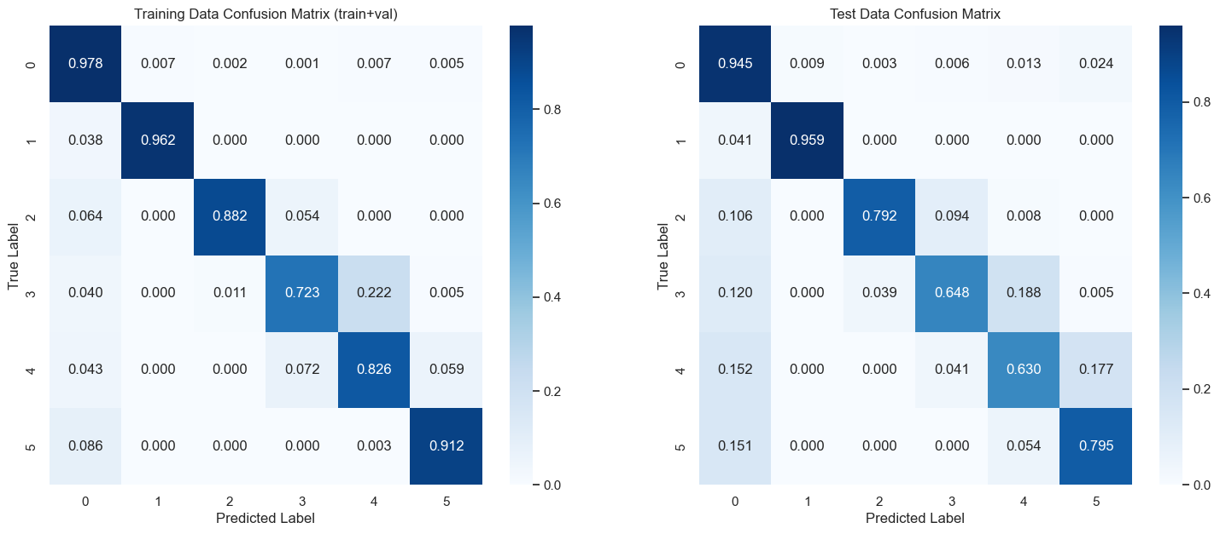
Considering same DAMASCONI for invarince

Slide 22
REFERENCES
Massari, L.; Bulletti, A.; Prasanna, S.; Mazzoni, M.; Frosini, F.; Vicari, E.; Pantano, M.; Staderini, F.; Ciuti, G.; Cianchi, F.; et al. A Mechatronic Platform for Computer Aided Detection of Nodules in Anatomopathological Analyses via Stiffness and Ultrasound Measurements. Sensors 2019, 19, 2512, doi: https://doi.org/10.3390/s19112512
Haibo He, Yang Bai, E. A. Garcia and Shutao Li, ”ADASYN: Adaptive synthetic sampling approach for imbalanced learning,” 2008 IEEE International Joint Conference on Neural Networks (IEEE World Congress on Computational Intelligence), Hong Kong, 2008, pp. 1322-1328, doi:10.1109/IJCNN.2008.4633969.

Slide 23
THANK YOU FOR YOUR ATTENTION

